Slide 1
Autonomous Vehicles
The Future of Self Driving Cars

Slide 2
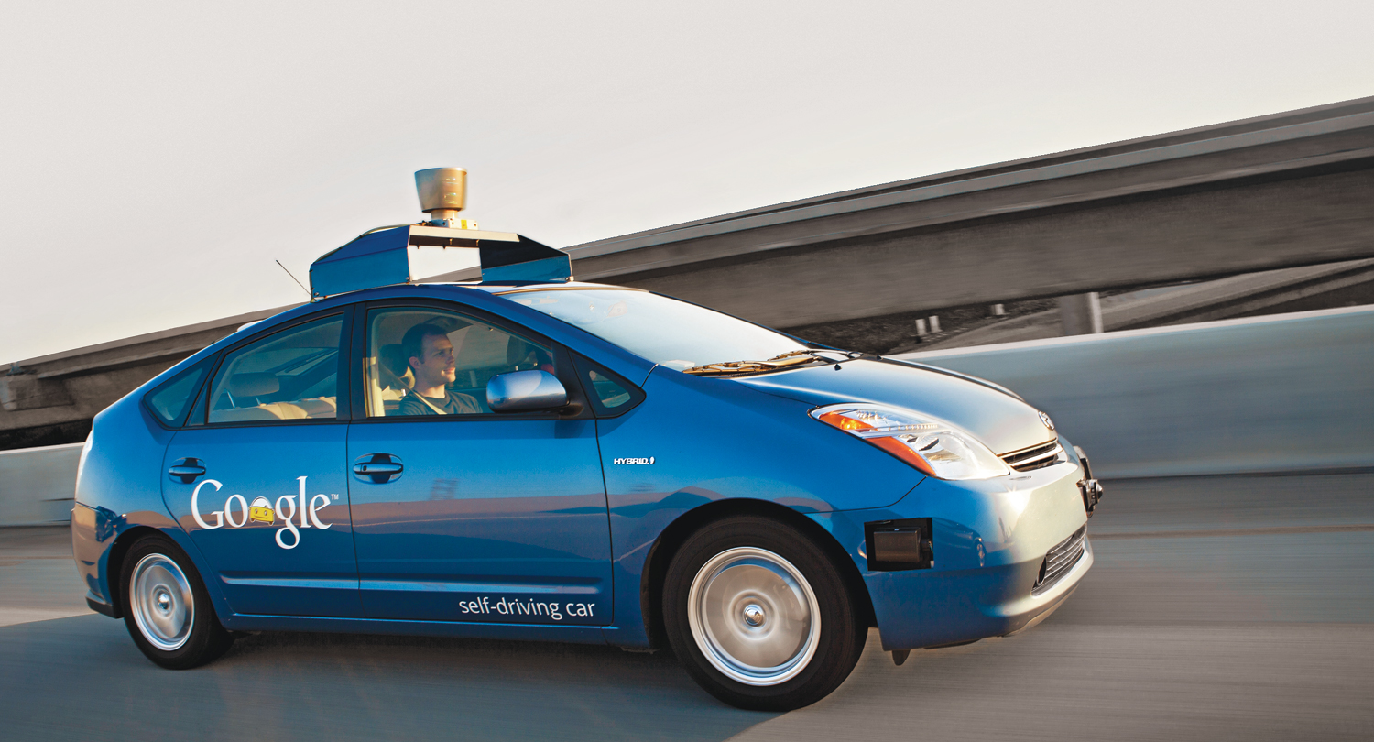
How Close Are We?

Slide 3
The Main Issues
Coping with humans
Extreme weather conditions
Software vulnerability
Legal and personal accountability

Slide 4
Coping With Humans
Entirely Autonomous
Semi Autonomous
Humans have no control over the car when it is driving to a destination.
Humans are able to drive the car like we do today.
What are the implications of these scenarios?

Slide 5
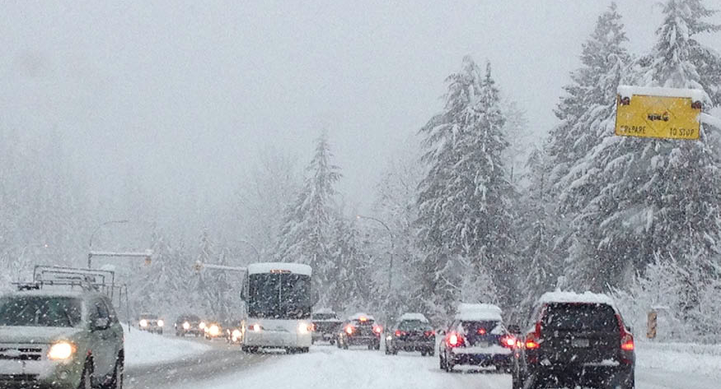
Extreme Weather

Slide 6
Major Concerns
Weather
Human Hazards
Heavy snow, rain, and fog
High winds
Extreme temperatures
People in the street
Pranksters
Temporary road blocks
Broken down vehicles
Human drivers
Emergencies in the car
Road Hazards
Pot holes
Downed trees
Wild life

Slide 7

Software Vulnerability
The Blue Screen

Slide 8
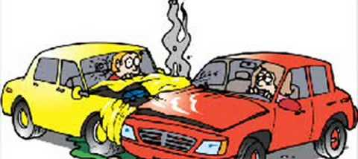
Legal Issues
The Driver, the Company, or the Programmers?

Slide 9
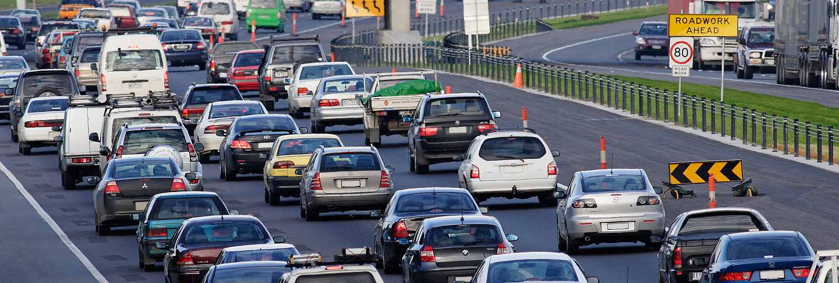
A World in Which Autonomous Cars Exist
Will the traffic be over?

Slide 10
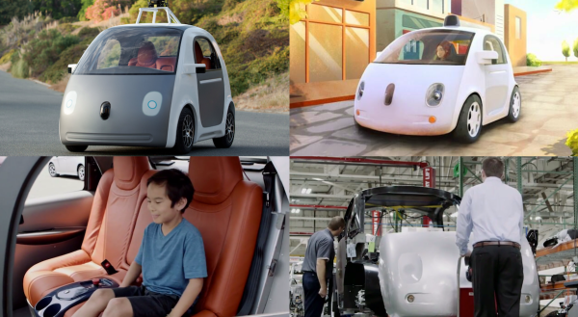
Google’s Concept

Slide 11
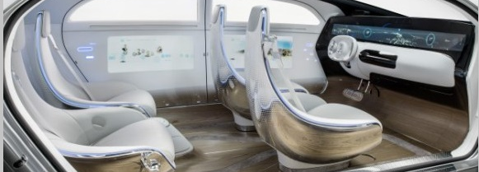
Mercedes Concepts
Mercedes-Benz f015 luxury

Slide 12
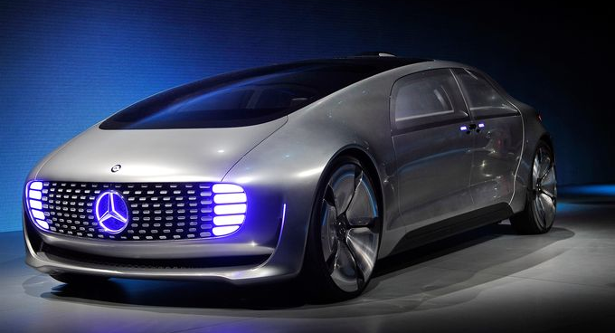

Slide 13
Some Thoughts
On Autonomous Cars
On People
Why do we hold computers in general to a higher standard than humans?
Some of us are already driving cars with automated functions.
Do people want self driving cars?

Slide 14
What Will the World Look Like?
Will you be able to send your car on errands without you?
If sustainable energy is developed, would we just use our cars instead of other modes of transport?

Slide 15
__DONE__

